Slide 1
Applied Geographic Information Systems and GIS Programming Day 4: Spatial Analysis using Raster Data
Yi Qiang
Department of Geography
University of Hawaii - Manoa

Slide 2
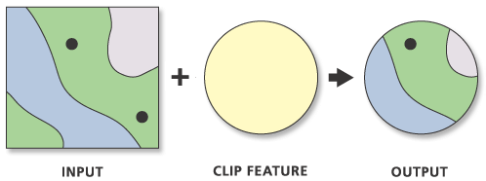
Clip (Spatial Overlay)
Only the attribute table of the input feature is saved in the output
FID | Name1 | Area1
1 | A | 200
2 | B | 300
FID | Name1 | Area1
1 | A | 200
2 | B | 300
FID | Name2 | Area2
1 | C | 100
INPUT
CLIP FEATURE
OUTPUT FEATURE

Slide 3
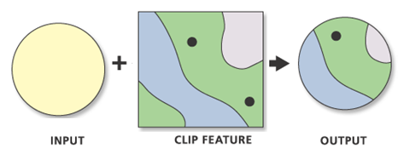
Clip (Spatial Overlay)
Only the attribute table of the input feature is saved in the output
FID | Name2 | Area2
1 | A | 200
2 | B | 300
FID | Name1 | Area1
1 | C | 100
FID | Name1 | Area1
1 | C | 100
INPUT
CLIP FEATURE
OUTPUT FEATURE

Slide 4
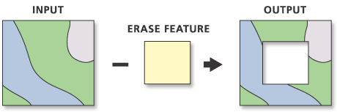
Erase (Spatial Overlay)
Only the attribute table of the input feature is saved in the output
FID | Name1 | Area1
1 | A | 200
2 | B | 300
FID | Name1 | Area1
1 | A | 200
2 | B | 300
FID | Name2 | Area2
1 | C | 100
INPUT
ERASE FEATURE
OUTPUT FEATURE

Slide 5
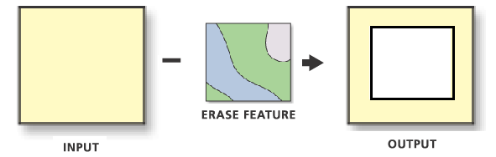
Erase (Spatial Overlay)
Only the attribute table of the input feature is saved in the output
FID | Name2 | Area2
1 | A | 200
2 | B | 300
FID | Name1 | Area1
1 | C | 100
FID | Name1 | Area1
1 | C | 100
INPUT
ERASE FEATURE
OUTPUT FEATURE

Slide 6
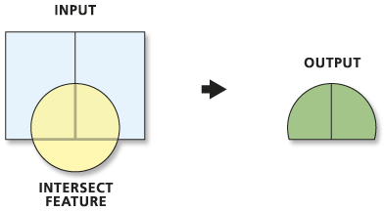
Intersect (Spatial Overlay)
The attribute tables of BOTH input and intersect feature are saved in the output
Note: you can convert the input features to feature layers, and then enable Use Ratio Policy to get the attributes in proportion to the intersected area.
FID | Name1 | Area1
1 | A | 100
2 | B | 200
FID | Name1 | Area1 | Name2 | Area2
1 | A | 100 | C | 300
2 | B | 200 | C | 300
FID | Name2 | Area2
1 | C | 300
INPUT 1
INPUT 2
OUTPUT FEATURE

Slide 7
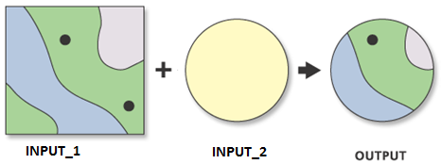
Intersect (Spatial Overlay)
The attribute tables of BOTH input and intersect feature are saved in the output
FID | Name1 | Area1
1 | A | 100
2 | B | 200
FID | Name1 | Area1 | Name2 | Area2
1 | A | 100 | C | 300
2 | B | 200 | C | 300
FID | Name2 | Area2
1 | C | 300
INPUT 1
INPUT 2
OUTPUT FEATURE

Slide 8
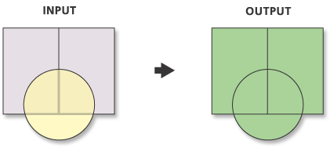
Union (Spatial Overlay)
The attribute tables of BOTH input and intersect feature are saved in the output
FID | Name1 | Area1 | Name2 | Area2
1 | A | 100 | C | 300
2 | A | 100
3 | B | 200 | C | 300
4 | B | 200
5 |  |  | C | 300
FID | Name1 | Area1
1 | A | 100
2 | B | 200
FID | Name2 | Area2
1 | C | 300
INPUT 1
INPUT 2
OUTPUT FEATURE

Slide 9
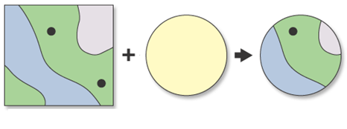
Answer to Question 3
What is the deforestation rate in protected forests?
Protected forests Deforested area Output
FID | Name1 | Area1
1 | A | 100
2 | B | 200
FID | Name1 | Area1 | Name2 | Area2
1 | A | 100 | C | 300
2 | B | 200 | C | 300
FID | Name2 | Area2
1 | C | 300
Protected forests
Deforested area
OUTPUT FEATURE

Slide 10
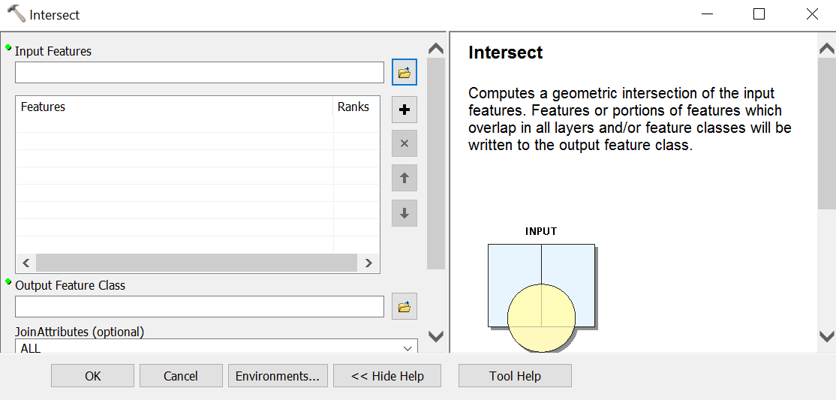
To Learn what the operations do
Tool Help in ArcGIS

Slide 11

To Learn what the operations do
ArcGIS online documentation
http://desktop.arcgis.com/
Search the tool

Slide 12
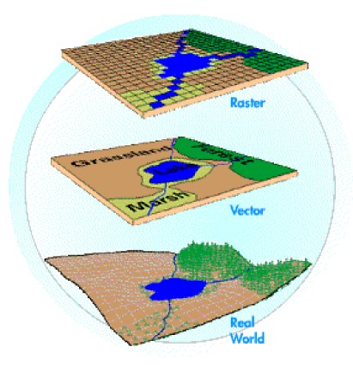
Spatial Data Models
Raster uses individual cells in a matrix, or grid, format to represent real world entities
Vector uses coordinates to store the shape of spatial data objects

Slide 13
Raster Data Model
Every cell has a value, even if it is a special value to indicate that there is “no data” or that data is “missing” at that location
Be careful for the difference between 0 and “no data”
The values are usually numbers, either:
actual values OR
codes representing an attribute

Slide 14
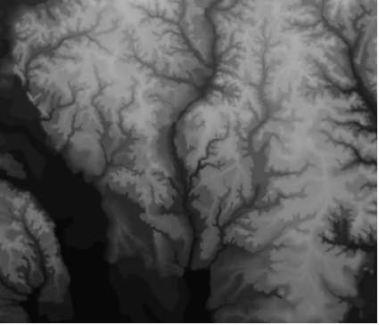
Cells - Absolute Values
In this instance, the value of the cell represents the value of the phenomenon of interest, e.g. the elevation at that pixel location.
Notes:
In the case of elevation, each cell contains a number that is the elevation of that cell.

Slide 15
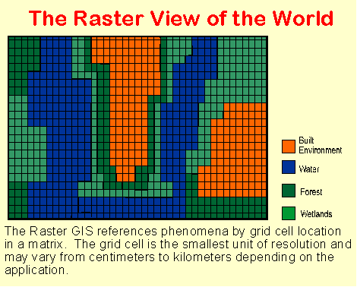
Cells - Coded Values
Here, the values stored in each cell are used as substitutes for categorical data, e.g. land cover classes
These values represent land cover categories
Value | Land type
1 | Built
2 | Water
3 | Forest
4 | Wetlands
Notes:
In this case, each cell contains a value which represents one particular type of land cover.

Slide 16
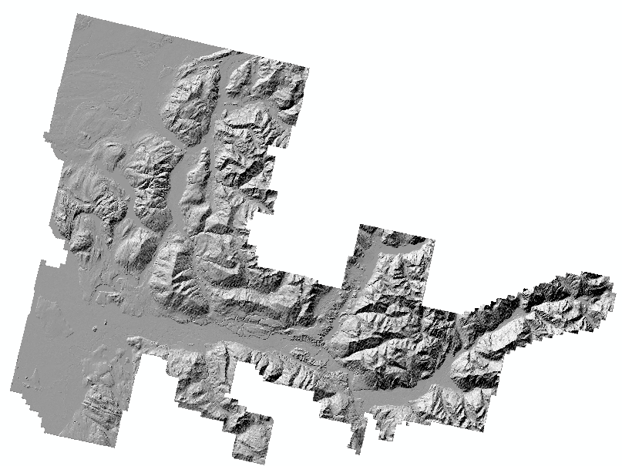
Grids and missing data
Missing data in raster are area that have no value
Usually because those areas have not being surveyed
Notes:
Missing values are represented by values which are software specific.
In the case of ArcInfo and ArcView, if you ever see a value of –9999, that indicates missing data.

Slide 17
Cell Size & Resolution
The size of the cells in the raster data model determines the resolution at which features can be represented
The resolution can have an effect on which features are represented in what locations:
10 m Resolution
5 m Resolution
1 m Resolution

Slide 18
Raster Data Model - Points
1 point = 1 cell
 |  |  | +
 | +
 |  |  | +
 | +
What problems do we have here?
2 points in single pixel
Point on the boundary between 2 or more cells

Slide 19
Raster Data Model - Lines
A line = a series of connected cells that portray length
Problems with this representation?
Lines may be narrower than pixels show
Curved lines can loose detail (e.g., if the curves are smaller than the pixel resolution can detect)

Slide 20
Raster Data Model - Areas
Area = a group of connected cells that portray a shape
What problems could we have with this representation?
What if a lake’s edge falls in a pixel?
Area calculations loose accuracy

Slide 21
Raster and Vector Data Model Comparison
Real World Features
Raster
Vector
•
•
•
“A raster model tells what occurs everywhere, while a vector model tells where every thing occurs”

Slide 22
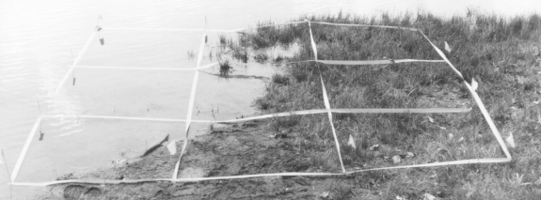
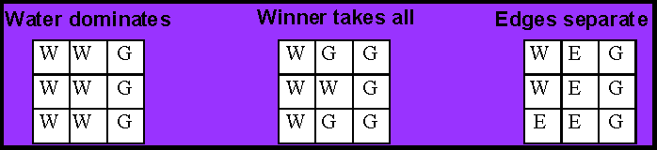
Rules for Assigning Cell Values
Cell values can be assigned to cells accorded to some set of rules, and selecting those rules differently can also effect the representation of features:
Notes:
Here’s another example. You have 9 cells here overlain on top of some water and some grass. What value would you assign to this cell?
Well, here are three possible decision rules that you could use.
We will talk more about cell resolution when we get to satellite data.

Slide 23
Raster Data Model - Storage
There is a trade-off between spatial resolution and data storage when we use the raster data model, e.g.
60 km satellite image with 10m cell size
6000 X 6000 = 36,000,000 cells
1 byte of attribute value (i.e. values 0-255)
~36 MB of disk storage!
60 km satellite image with 100m cell size
600 x 600 = 360,000 cells
360 KB of data… 1% the size of the other one
Notes:
This is just simple math.

Slide 24
Raster Data Model – Compaction
Because the raster data model records a value for each and every cell in a grid, it is very storage intensive, meaning that it can use a lot of memory and disk space to represent a theme
Compaction techniques are used in conjunction with raster data to reduce the amount of required storage space to a more manageable amount

Slide 25
Raster Data Storage – No Compaction
This approach represents each cell individually in the file:
max. cell value
rows
columns
0
0
0
0
0
0
0
0
0
0
0
0
0
0
0
0
0
0
0
0
10, 10, 1
0 0 0 0 0 0 0 0 0 0
0 0 0 0 0 0 0 0 0 0
0 0 0 0 1 1 1 1 0 0
0 0 0 0 1 1 1 1 0 0
0 0 1 1 1 1 1 1 0 0
0 0 1 1 1 1 1 1 0 0
0 0 1 1 1 1 1 1 0 0
0 0 1 1 1 1 1 1 0 0
0 0 0 0 0 0 0 0 0 0
0 0 0 0 0 0 0 0 0 0
0
0
0
0
1
1
1
1
0
0
0
0
0
0
1
1
1
1
0
0
0
0
1
1
1
1
1
1
0
0
0
0
1
1
1
1
1
1
0
0
0
0
1
1
1
1
1
1
0
0
0
0
1
1
1
1
1
1
0
0
0
0
0
0
0
0
0
0
0
0
0
0
0
0
0
0
0
0
0
0
Problem: too much redundancy
103 values

Slide 26
Raster Data Storage – Run Length Encoding
This approach takes advantage of patterns in the data, taking advantage of the repetition of values in a row:
0,10,1
0, 10
0, 10
0, 4, 1, 4, 0,2
0, 4, 1, 4, 0,2
0, 2, 1, 6, 0,2
0, 2, 1, 6, 0,2
0, 2, 1, 6, 0,2
0, 2, 1, 6, 0,2
0, 10
0, 10
0
0
0
0
0
0
0
0
0
0
0
0
0
0
0
0
0
0
0
0
0
0
0
0
1
1
1
1
0
0
0
0
0
0
1
1
1
1
0
0
0
0
1
1
1
1
1
1
0
0
row by row
0
0
1
1
1
1
1
1
0
0
0
0
1
1
1
1
1
1
0
0
0
0
1
1
1
1
1
1
0
0
0
0
0
0
0
0
0
0
0
0
0
0
0
0
0
0
0
0
0
0
45 values
There is a tendency towards spatial autocorrelation; for nearby cells to have similar values - values often occur in runs across several cells

Slide 27
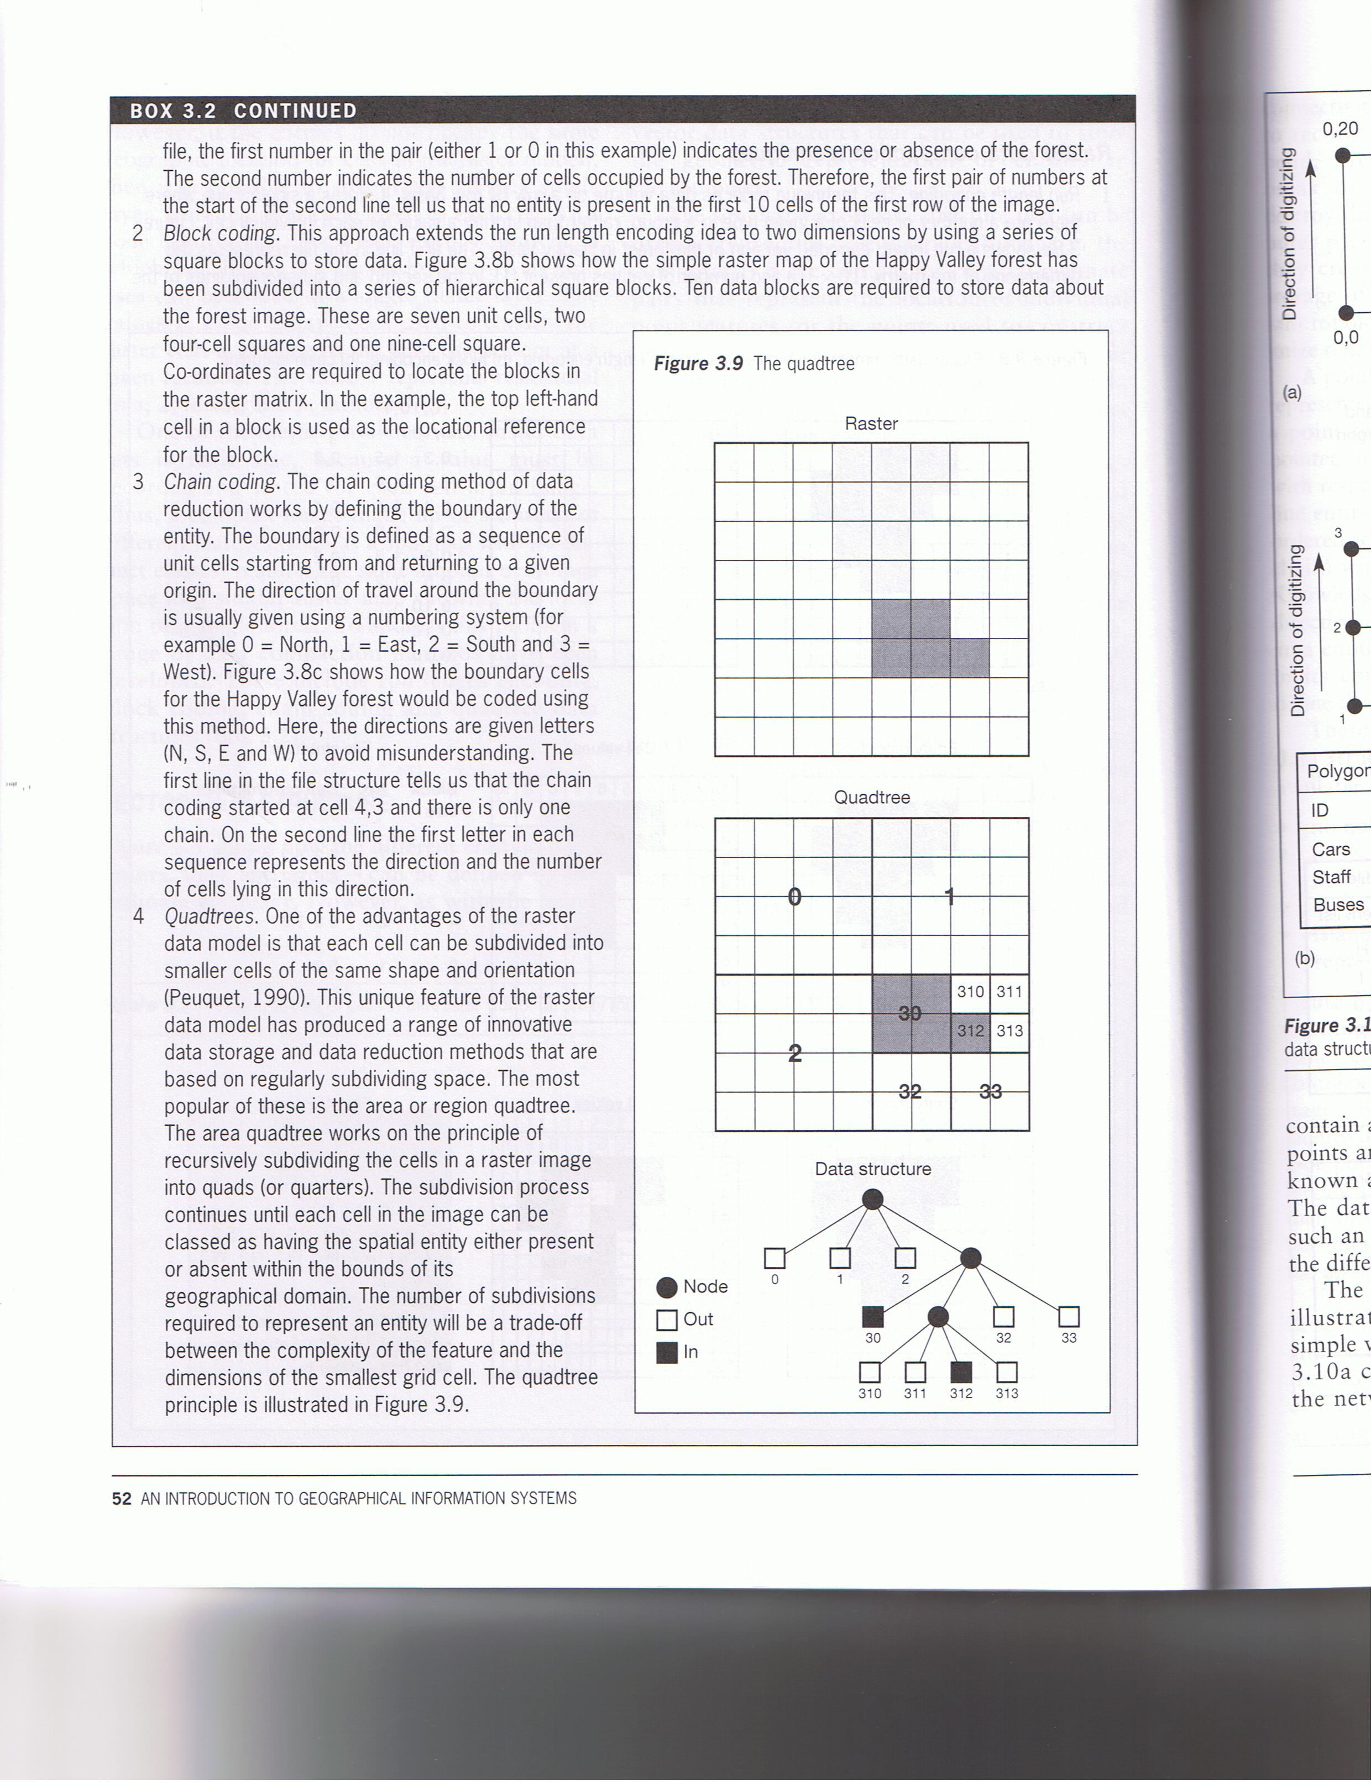
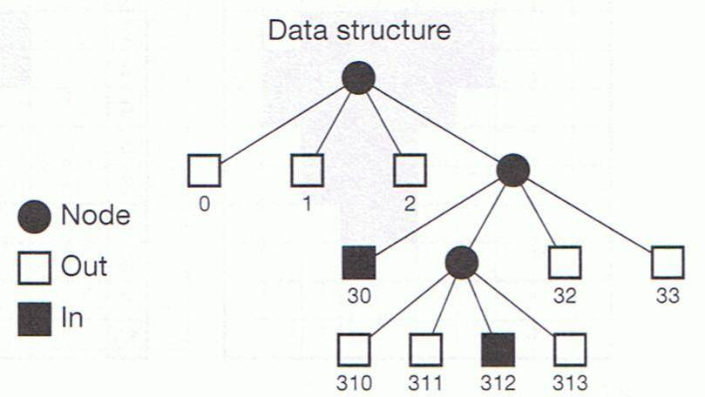
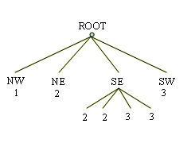
Raster Data Compression Models: Quadtrees
Recursively divides an area into four quadrants until all the quadrants (at all levels) are homogeneous

Slide 28
Raster Data Model - Advantages
The data structure is much simpler
It is easy to overlay and combine layers
It is easy to apply equations to the entire surface (map algebra)
Example: New_GRID = GRID_1 + GRID_2
Raster data is easily integrated with satellite (and other remotely-sensed) data
Writing programs to manipulate raster is easier
It is easy to do simulation modeling due to uniform size and shape of grids (i.e. it is easy to define uniform modeling units)

Slide 29
Raster Data Model - Disadvantages
Because a value must be stored for each and every cell in a grid, there is a great deal of redundancy and large storage requirements
Location can be captured only as accurately as the resolution allows, which is determined by the cell size
Spatial analyses that are based on topological relationships are not well supported by this model
Changing resolution (i.e., cell size) can be complicated

Slide 30
Which Data Model Should You Use?
This can depend upon the type of data you’re using and what goals you’re trying to achieve
Vector model: discrete features such as rivers, roads, buildings, and political boundaries
Raster model: continuous features such as elevation
Usually your choice is determined by data availability

Slide 31
Map algebra
Concept introduced and developed by Dana Tomlin and Joseph Berry (1970’s)
Cell by Cell combination of raster data layers
- Operation is applied to each pixel in the raster
- Overlay operations is applied to pixels of the different layers at the same position (no boundary intersection).

Slide 32
Common types of Map algebra
Local Operations
Logical operations (e.g., Boolean)
Arithmetic operations (e.g., +, -,*, /)
Overlay operations (e.g., detect association)
Local (e.g., reclassification)
Focal Operations
Statistics (mean, sum, max, min, stdv) in the neighborhood.
Zonal Operations
Statistics (mean, sum, max, min, stdv) in cells of the same value
Cost surface analysis

Slide 33
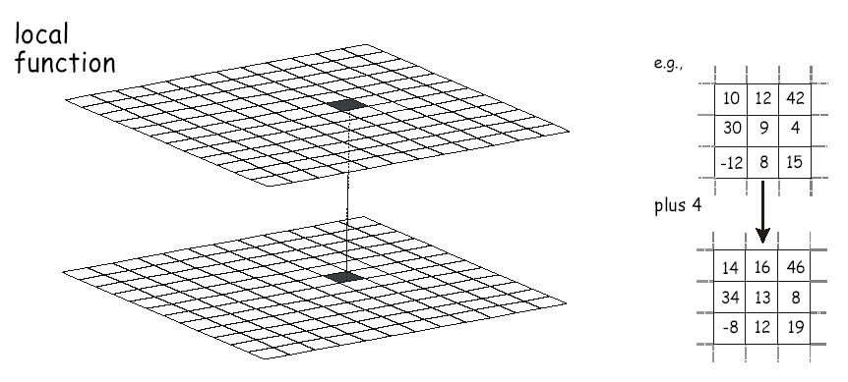
Scope: Local operations
Notes:
As with vector analysis, the scope of raster analysis can be classified as local , neighborhood or global

Slide 34
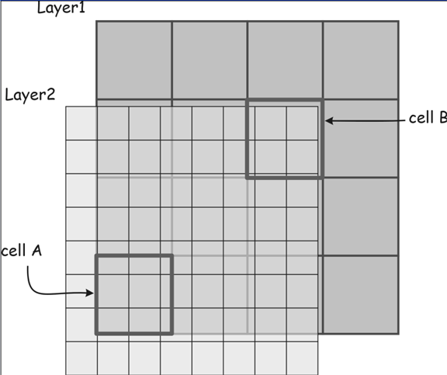
Resampling
Raster data need to be in the same resolution (cell size) and grid before map algebra
Resampling can convert a raster from one resolution to another
Notes:
Incompatible cell sized and boundaries can cause problems with multi-layer raster operations. What cell value would you choose from layer 2 to combine with layer 1n and a portion of cell B is undefined.
Ambiguities are best resolved by resampling prior to layer combination

Slide 35
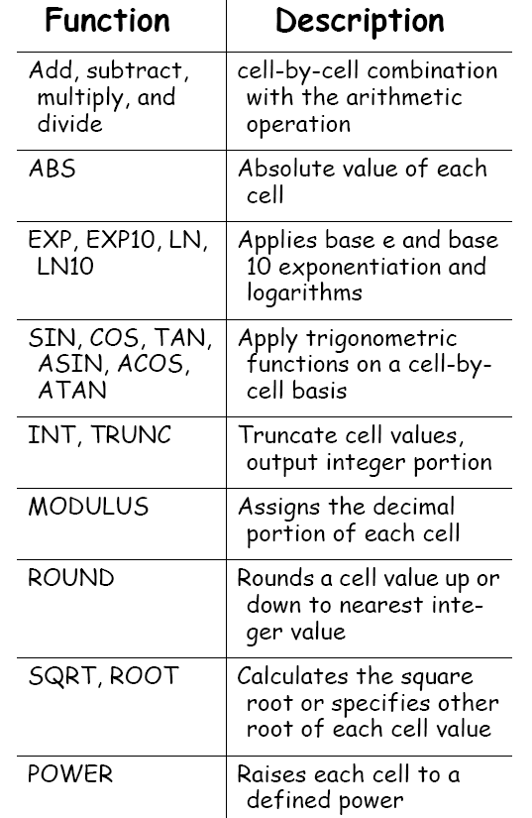
Many Local Functions

Slide 36
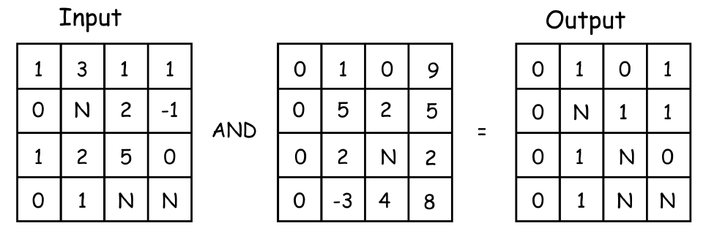
Logical Operations AND
Non-zero values are “true”, zero values are “false”
N = null values

Slide 37
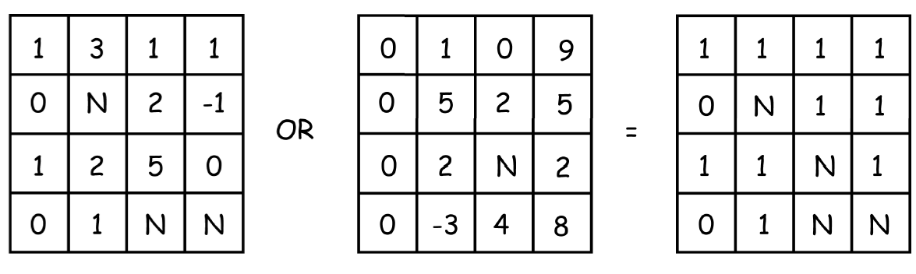
Logical Operations OR
Non-zero values are “true”, zero values are “false”
N = null values

Slide 38
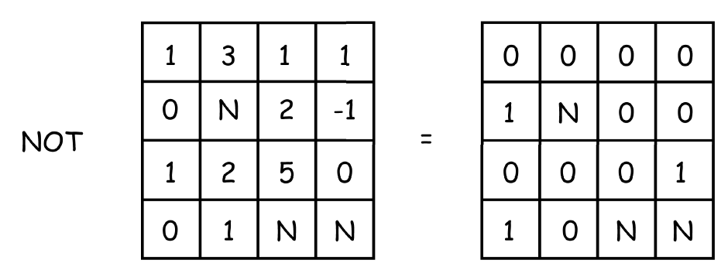
Logical Operations NOT

Slide 39
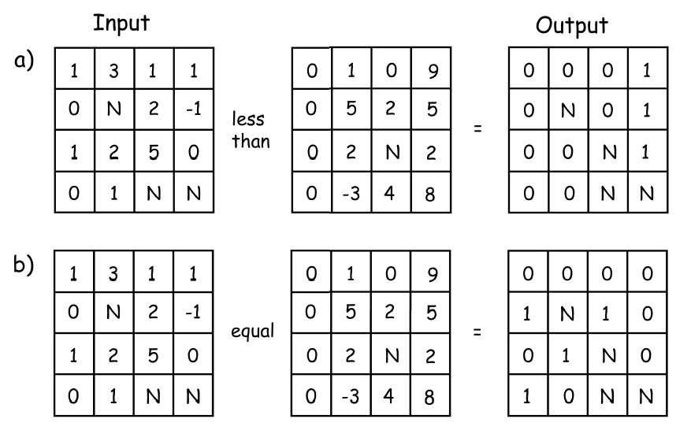
More Local Functions – logical comparisons

Slide 40
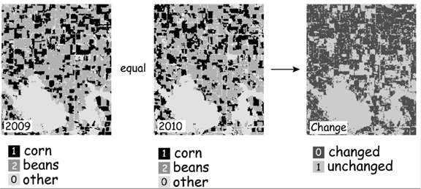
An Example of a Logical Operation

Slide 41
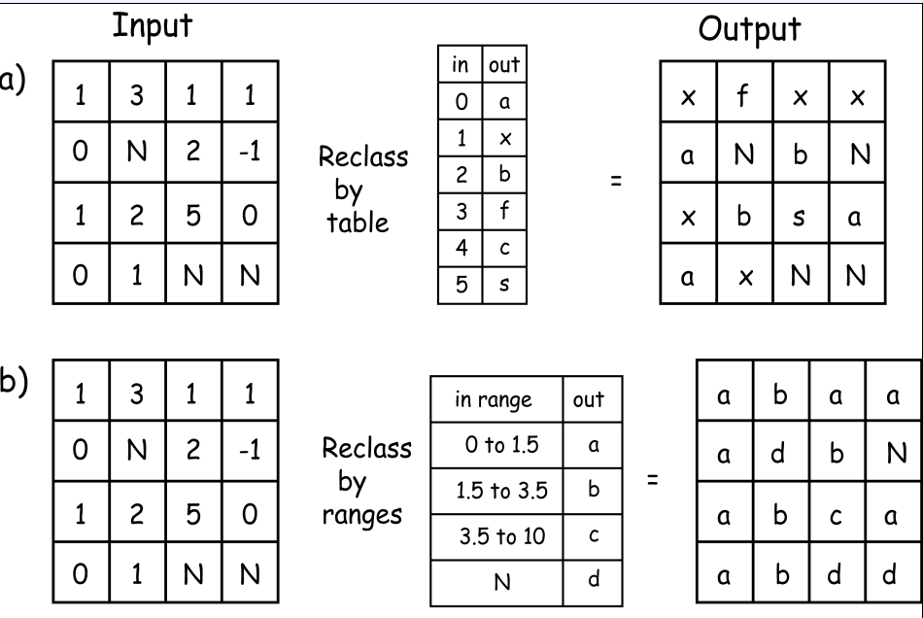
Reclassification
Notes:
Raster reclassification assigns output values that depend on a specific st of input values.

Slide 42
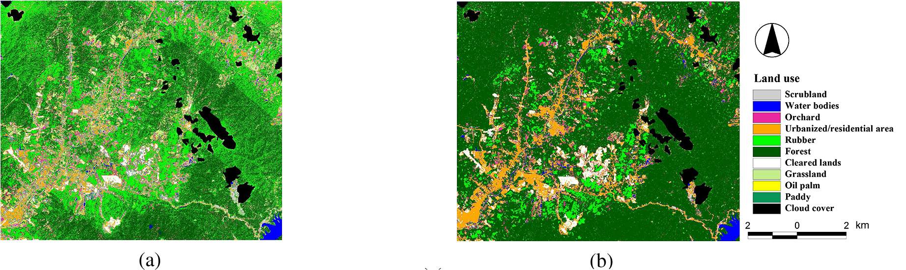
Reclassification Example
Reclassify
Remote sensing image (continuous value)
Land cover map (categorical value)

Slide 43
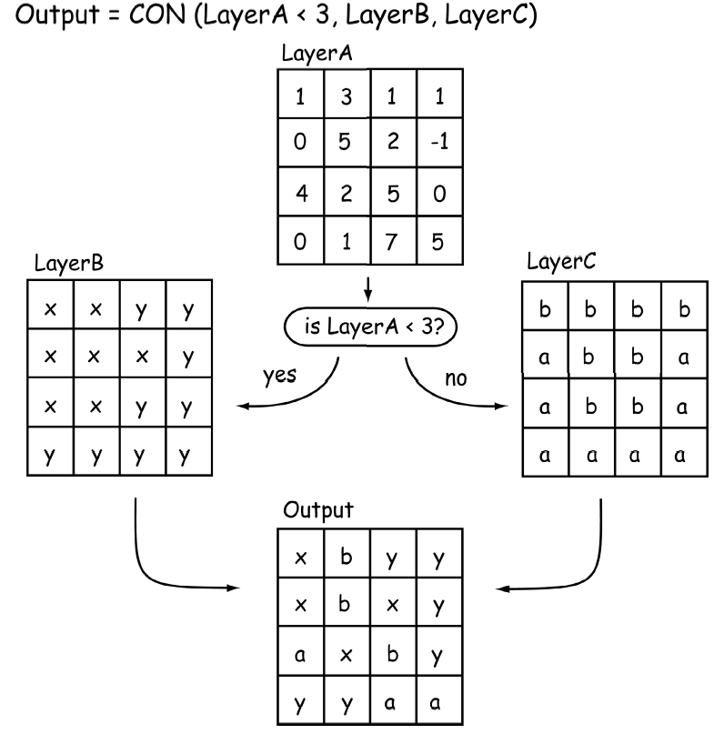
Conditional Function
If true
some value
If not true
some other value

Slide 44
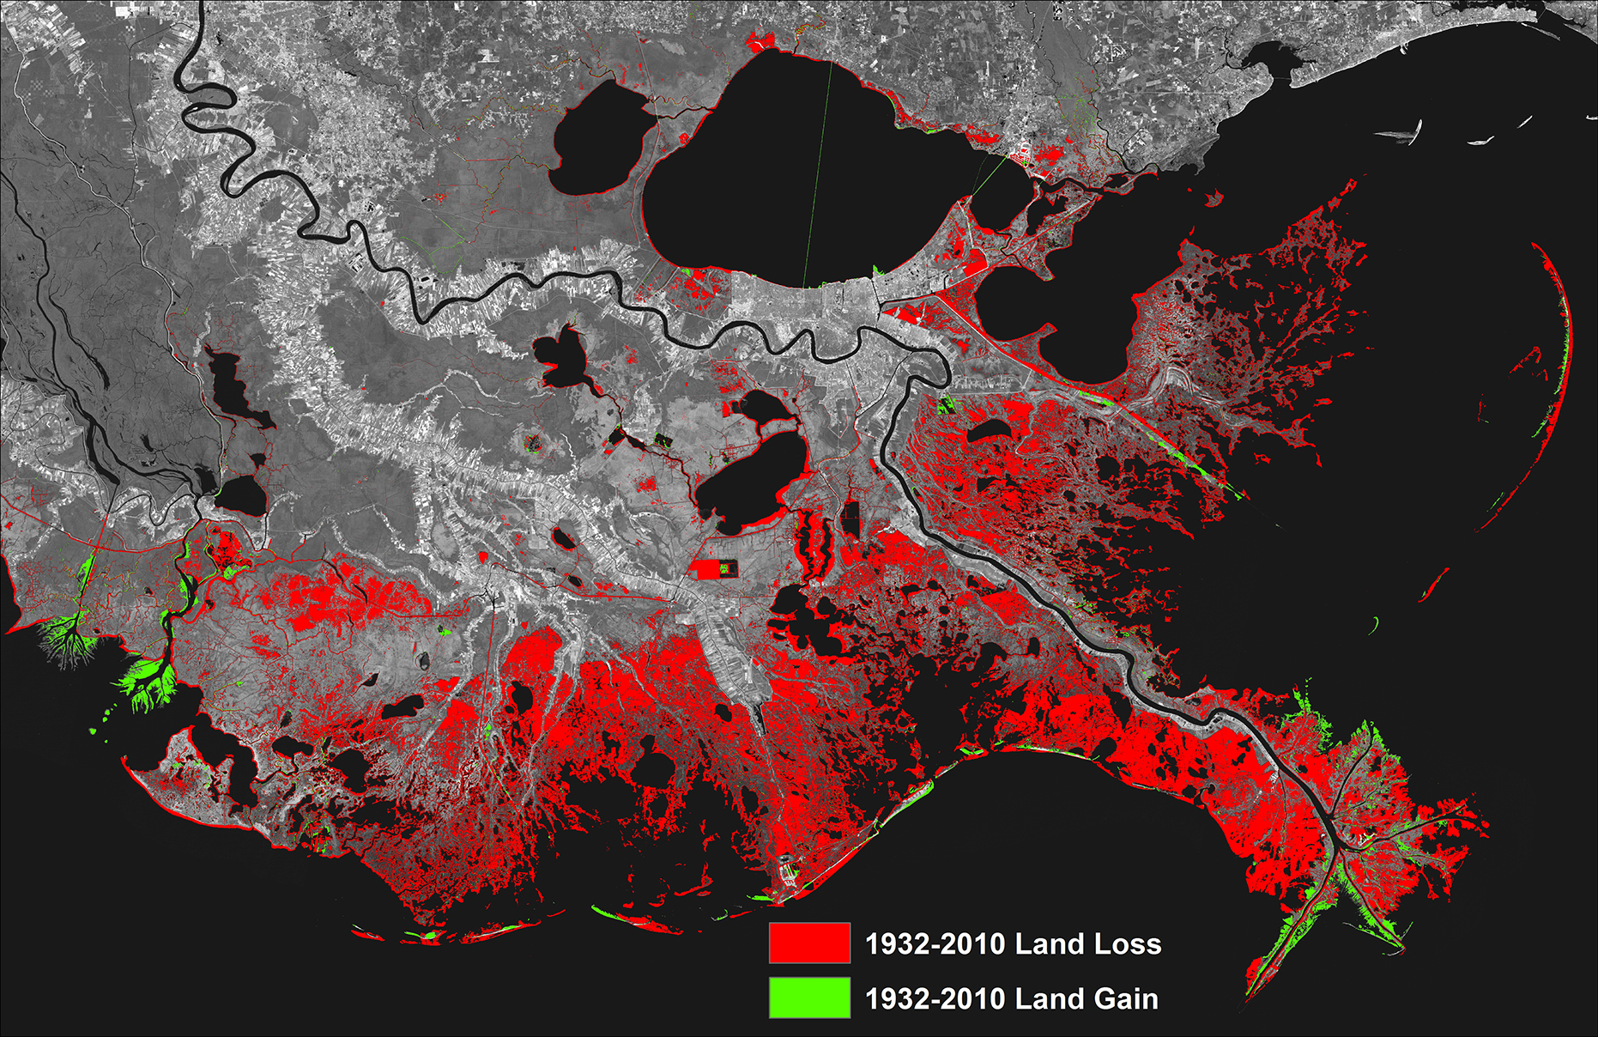
Example of Conditional Operator

Slide 45
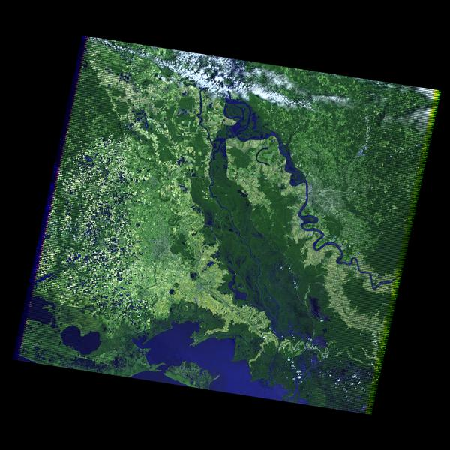
W | L | L | L
W | L | L | L
W | W | W | L
W | W | L | L
Reclassify
Conditional function:
if Y1=W AND Y2= L
Value = Land gain,
Else if Y1=L AND Y2= W,
Value = Land loss,
Else
unchanged
N | - | - | N
N | - | N | N
N | N | + | N
N | + | N | N
Remote sensing image in Year 1
W | W | W | L
W | W | L | L
W | W | L | L
W | L | L | L
Reclassify
+ : land gain
- : land loss
N: No change
Remote sensing image in Year 2

Slide 46
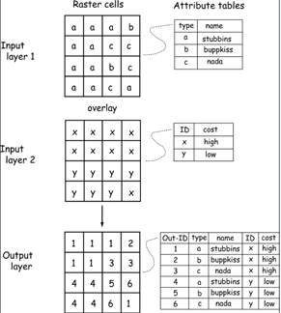
Intersect in Raster

Slide 47
Multiplication
1 | 0 | 1
1 | 0 | 1
1 | 0 | 1
1 | 1 | 1
0 | 0 | 1
0 | 0 | 1
First * Second
1 | 0 | 1
0 | 0 | 1
0 | 0 | 1
0*0=0
0*1=0
1*1=1

Slide 48
Addition
1 | 0 | 1
1 | 0 | 1
1 | 0 | 1
1 | 1 | 1
0 | 0 | 1
0 | 0 | 1
First + Second
2 | 1 | 2
1 | 0 | 2
1 | 0 | 2
0+0=0
0+1=1
1+1=2

Slide 49
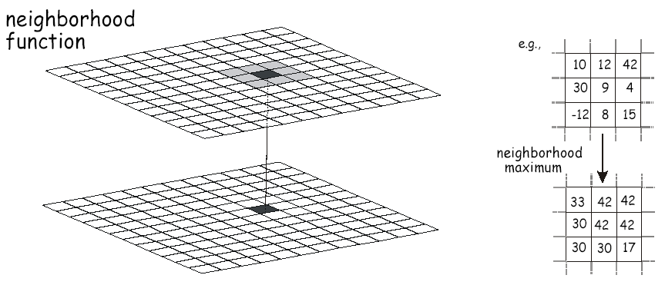
Neighborhood operations
Notes:
Vector neighborhoods are not well-defined and depends upon the size and shape of the feature and neighboring feature, Raster neighborhood is better defined.

Slide 50
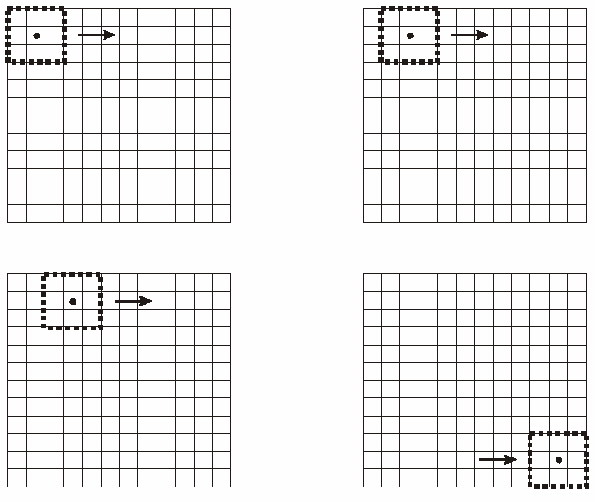
Neighborhood Operations
Moving Windows
(Windows can be any size; often odd to provide a center)

Slide 51
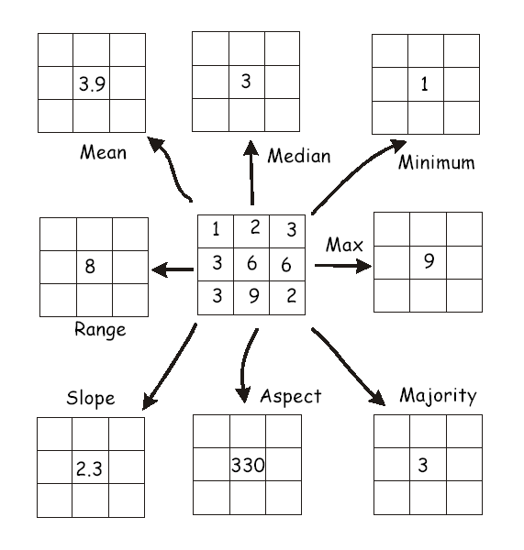
Neighborhood Operations

Slide 52
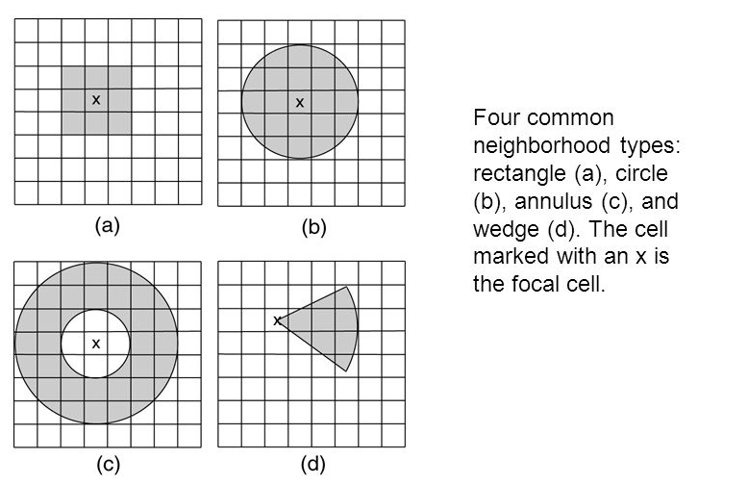
Shape of Neighborhoods

Slide 53
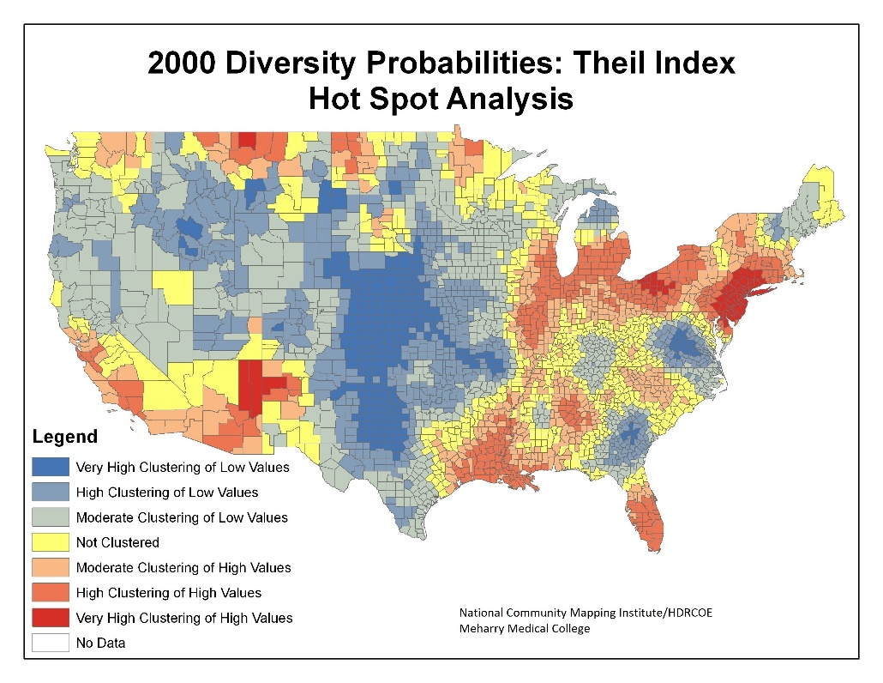
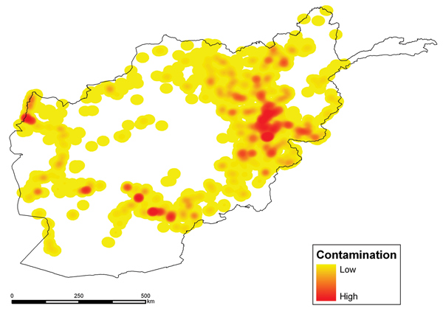
Neighborhood is important in geography
Neighbored operations can calculate density, detect clusters of things in space
It represents the First Law of Geography: “Everything is related to everything else, but closer things are more related”.
Density map
Cluster (hotspot) detection

Slide 54
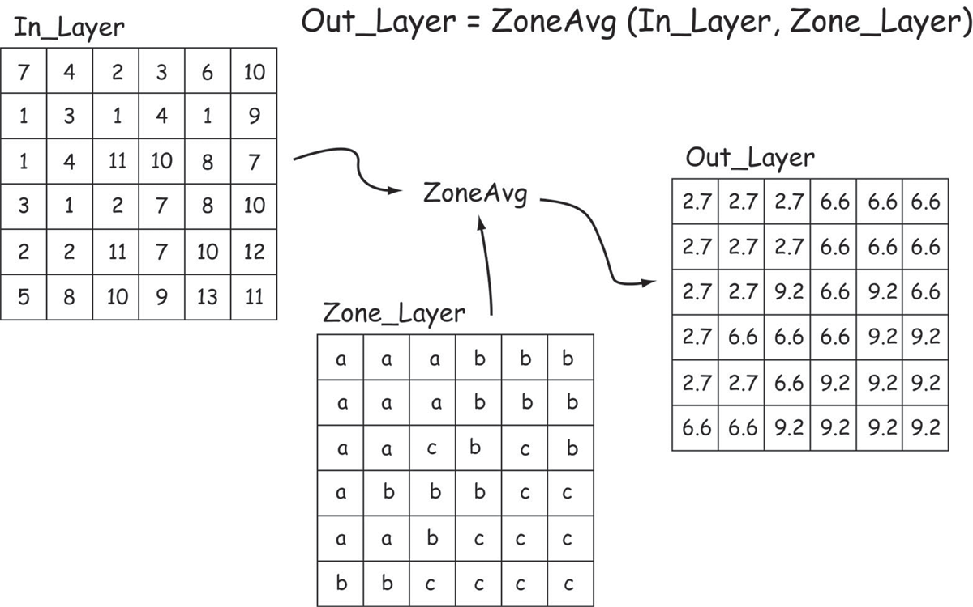
Zonal Functions
Notes:
Zonal operations apply functions based on defined regions or zones.

Slide 55
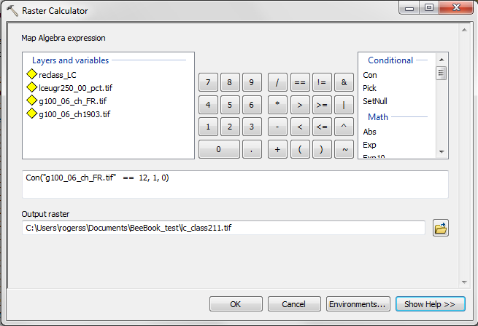
Raster calculator in ArcGIS

Slide 56
Cost Surface Analysis (Least cost path)
The minimum cost of reaching cells in a layer from one or more sources cells
“travel costs”
Time to school; hospital;
Chance of noxious foreign weed spreading out from an introduction point
Chance of wildfire spreading from an ignition point
Units can be money, time, difficulty, risk etc.
Distance measure is combined with a fixed cost per unit distance to calculate travel cost

Slide 57
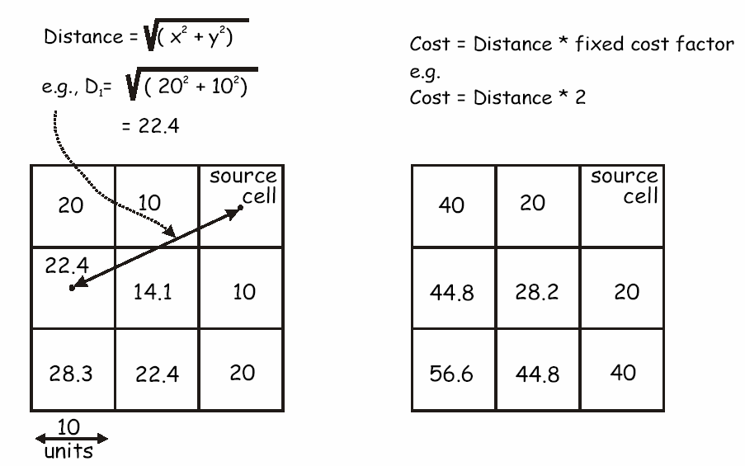
Constant travel cost
Constant travel cost per distance unit
Distance to the source cell in flat plane
Constant travel cost
2 per distance unit
Notes:
A cost surface is based on a fixed cost such as miles per gallon.

Slide 58
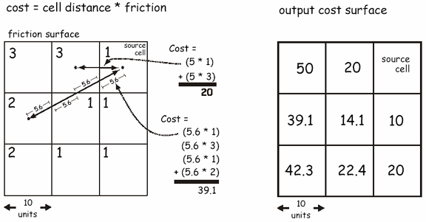
Varying travel cost
The cost per unit travel distance varies from cell to cell
Notes:
Variable cost
Total distance is 22.4/ 4 segments = 5.6

Slide 59
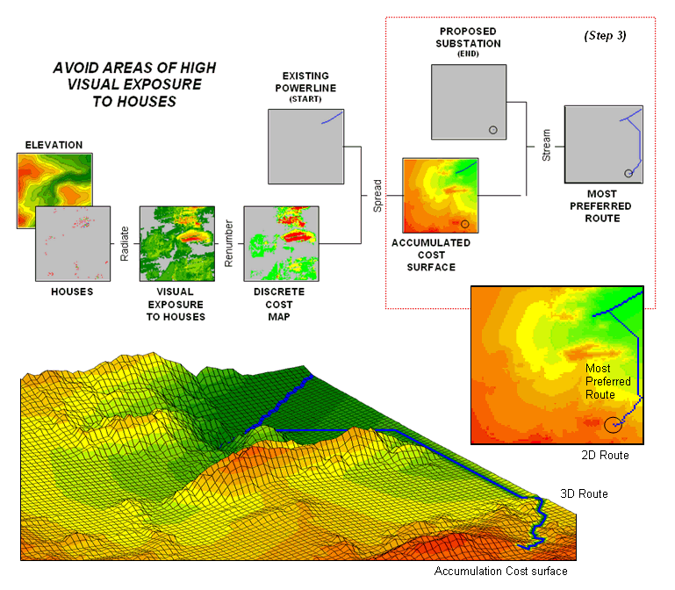
Example of Least Cost Path Analysis

Slide 60
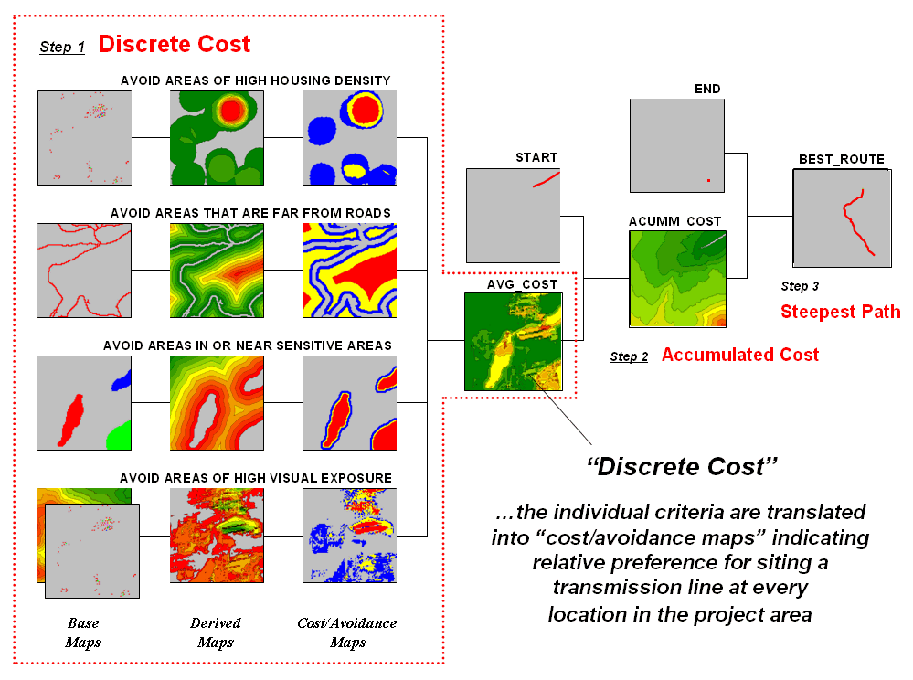

Slide 61
Tomorrow (Friday 8:30-11:30am), Lab Exercise
Location: No.1 Building, 21st Floor, Room 101.

